Slide 1


3D RENDERS
Shreemaa Mother and Child Care Hospital

Slide 2
day VIEW

Slide 3
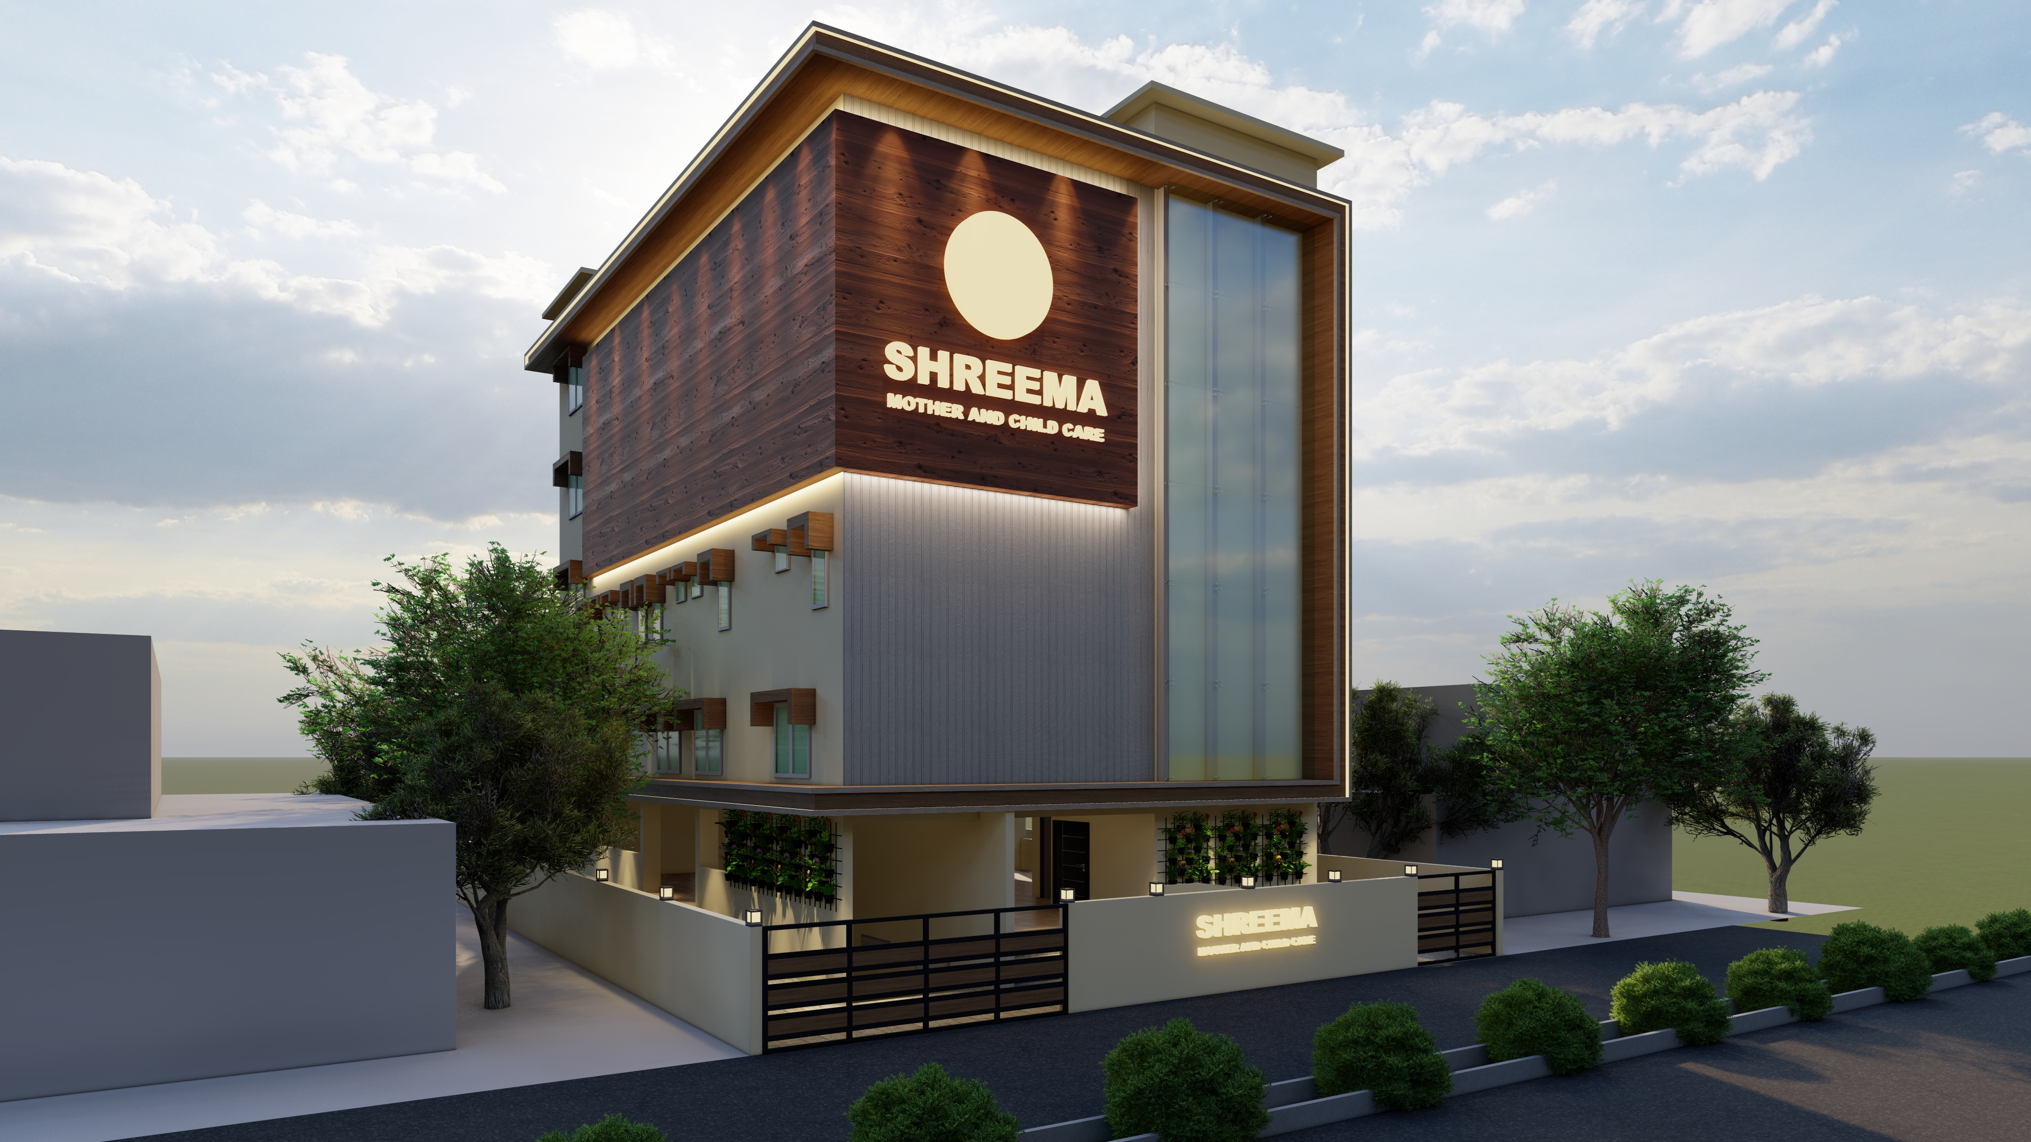

Slide 4
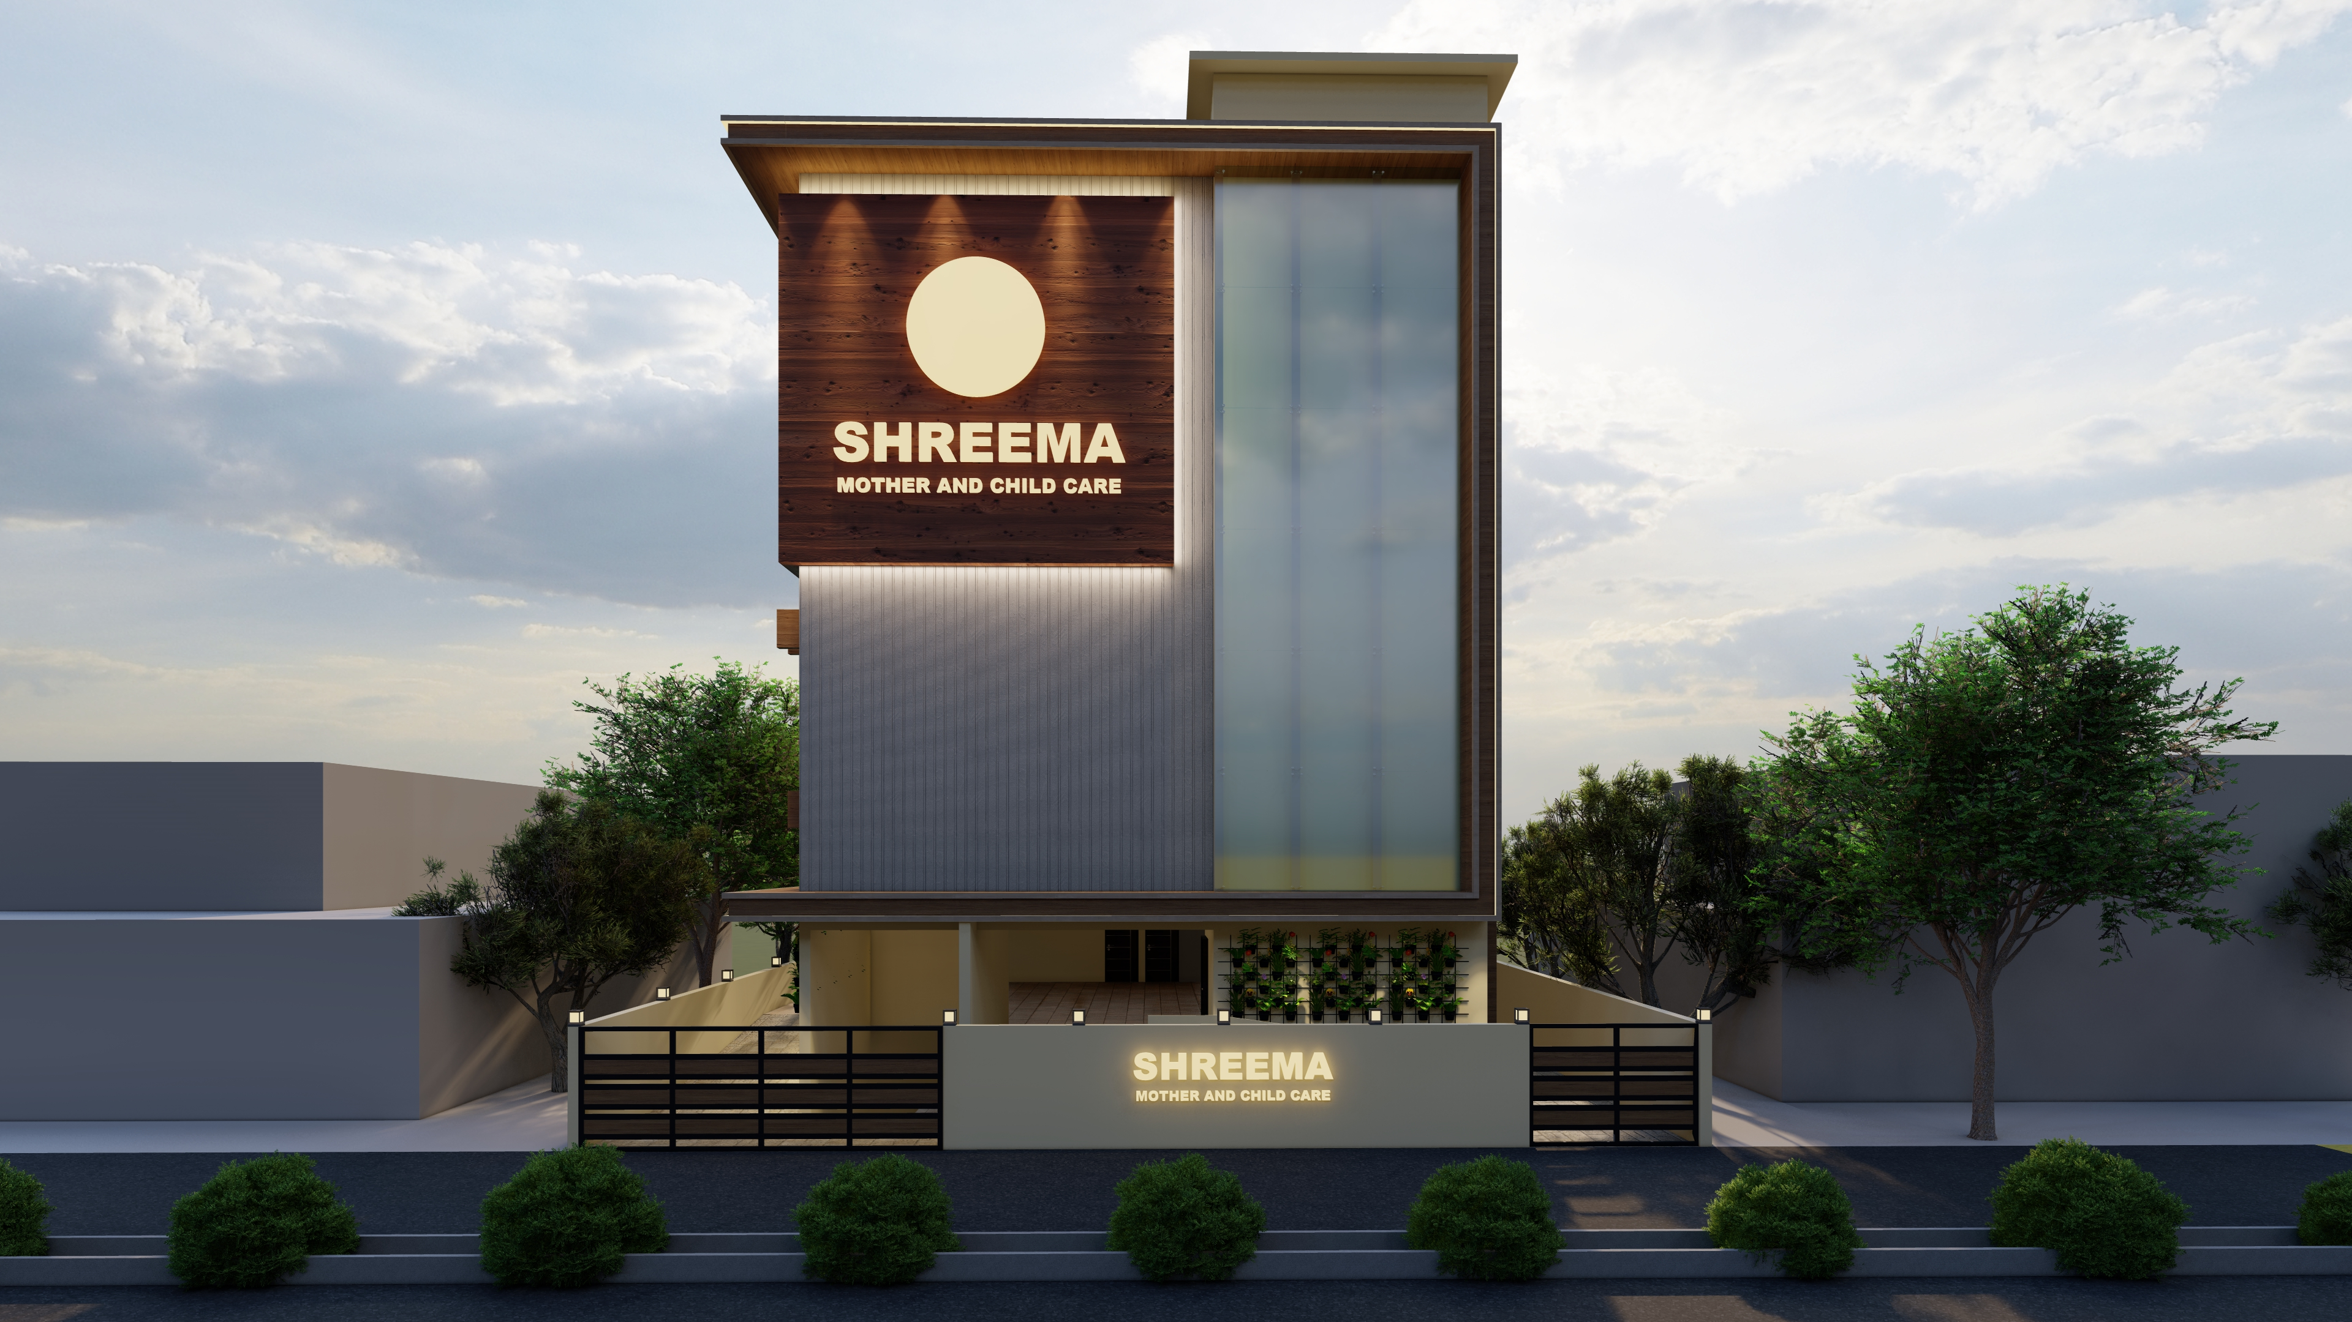

Slide 5
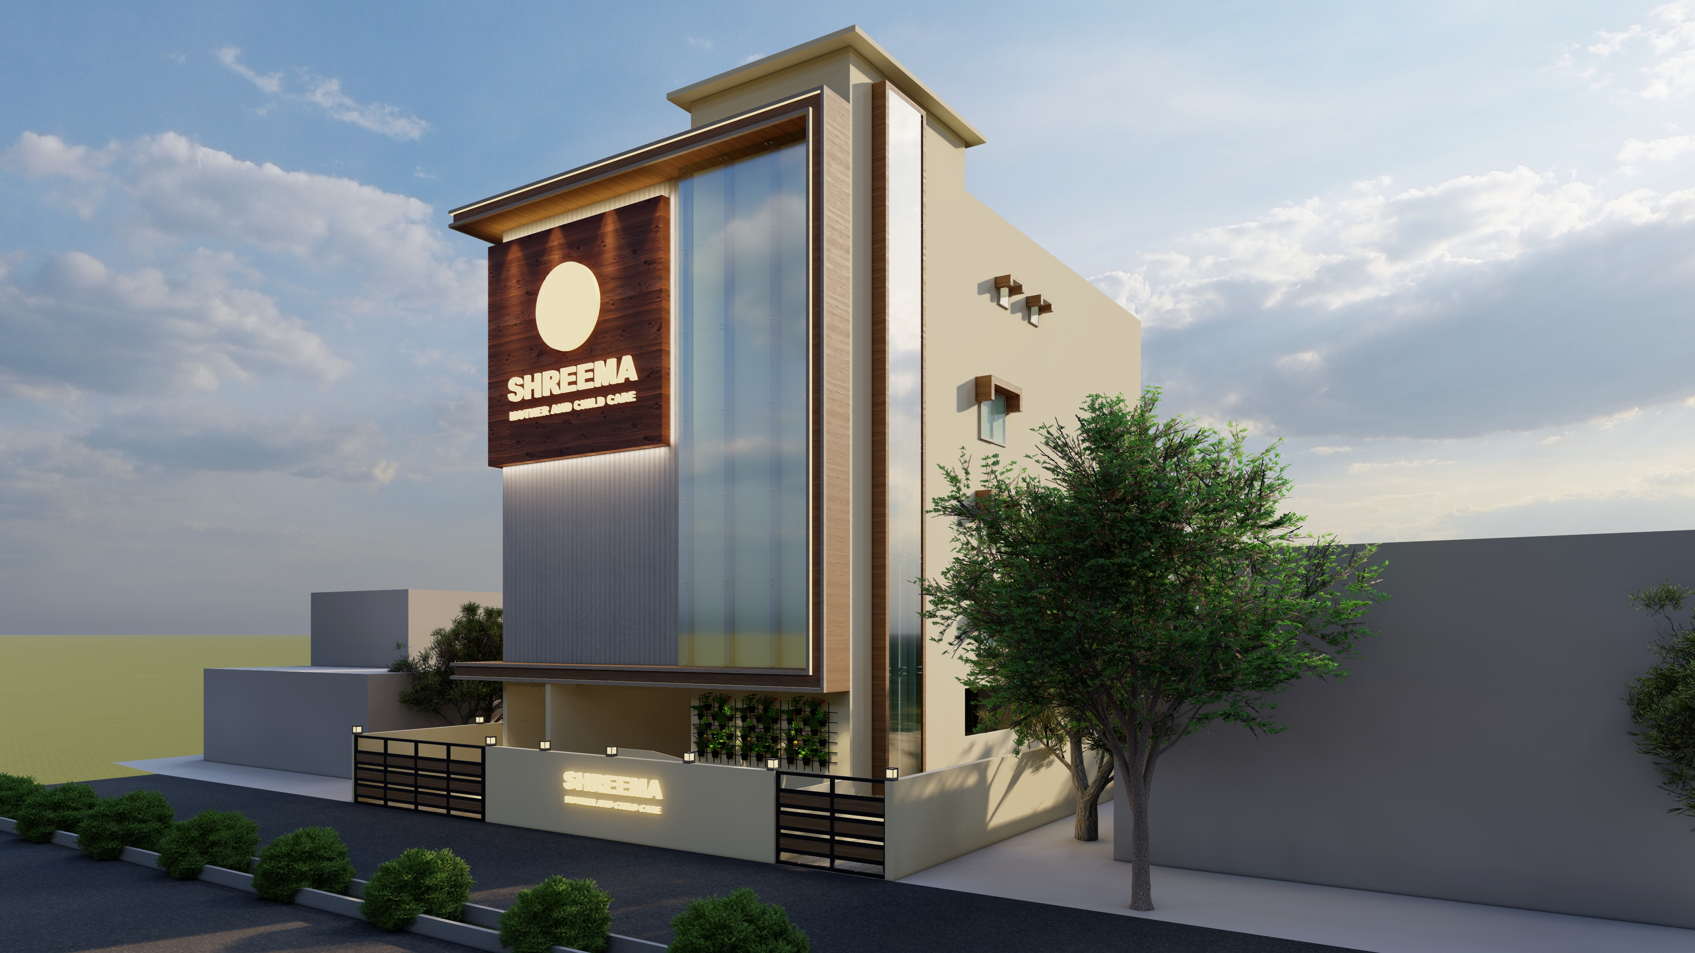

Slide 6
night VIEW

Slide 7
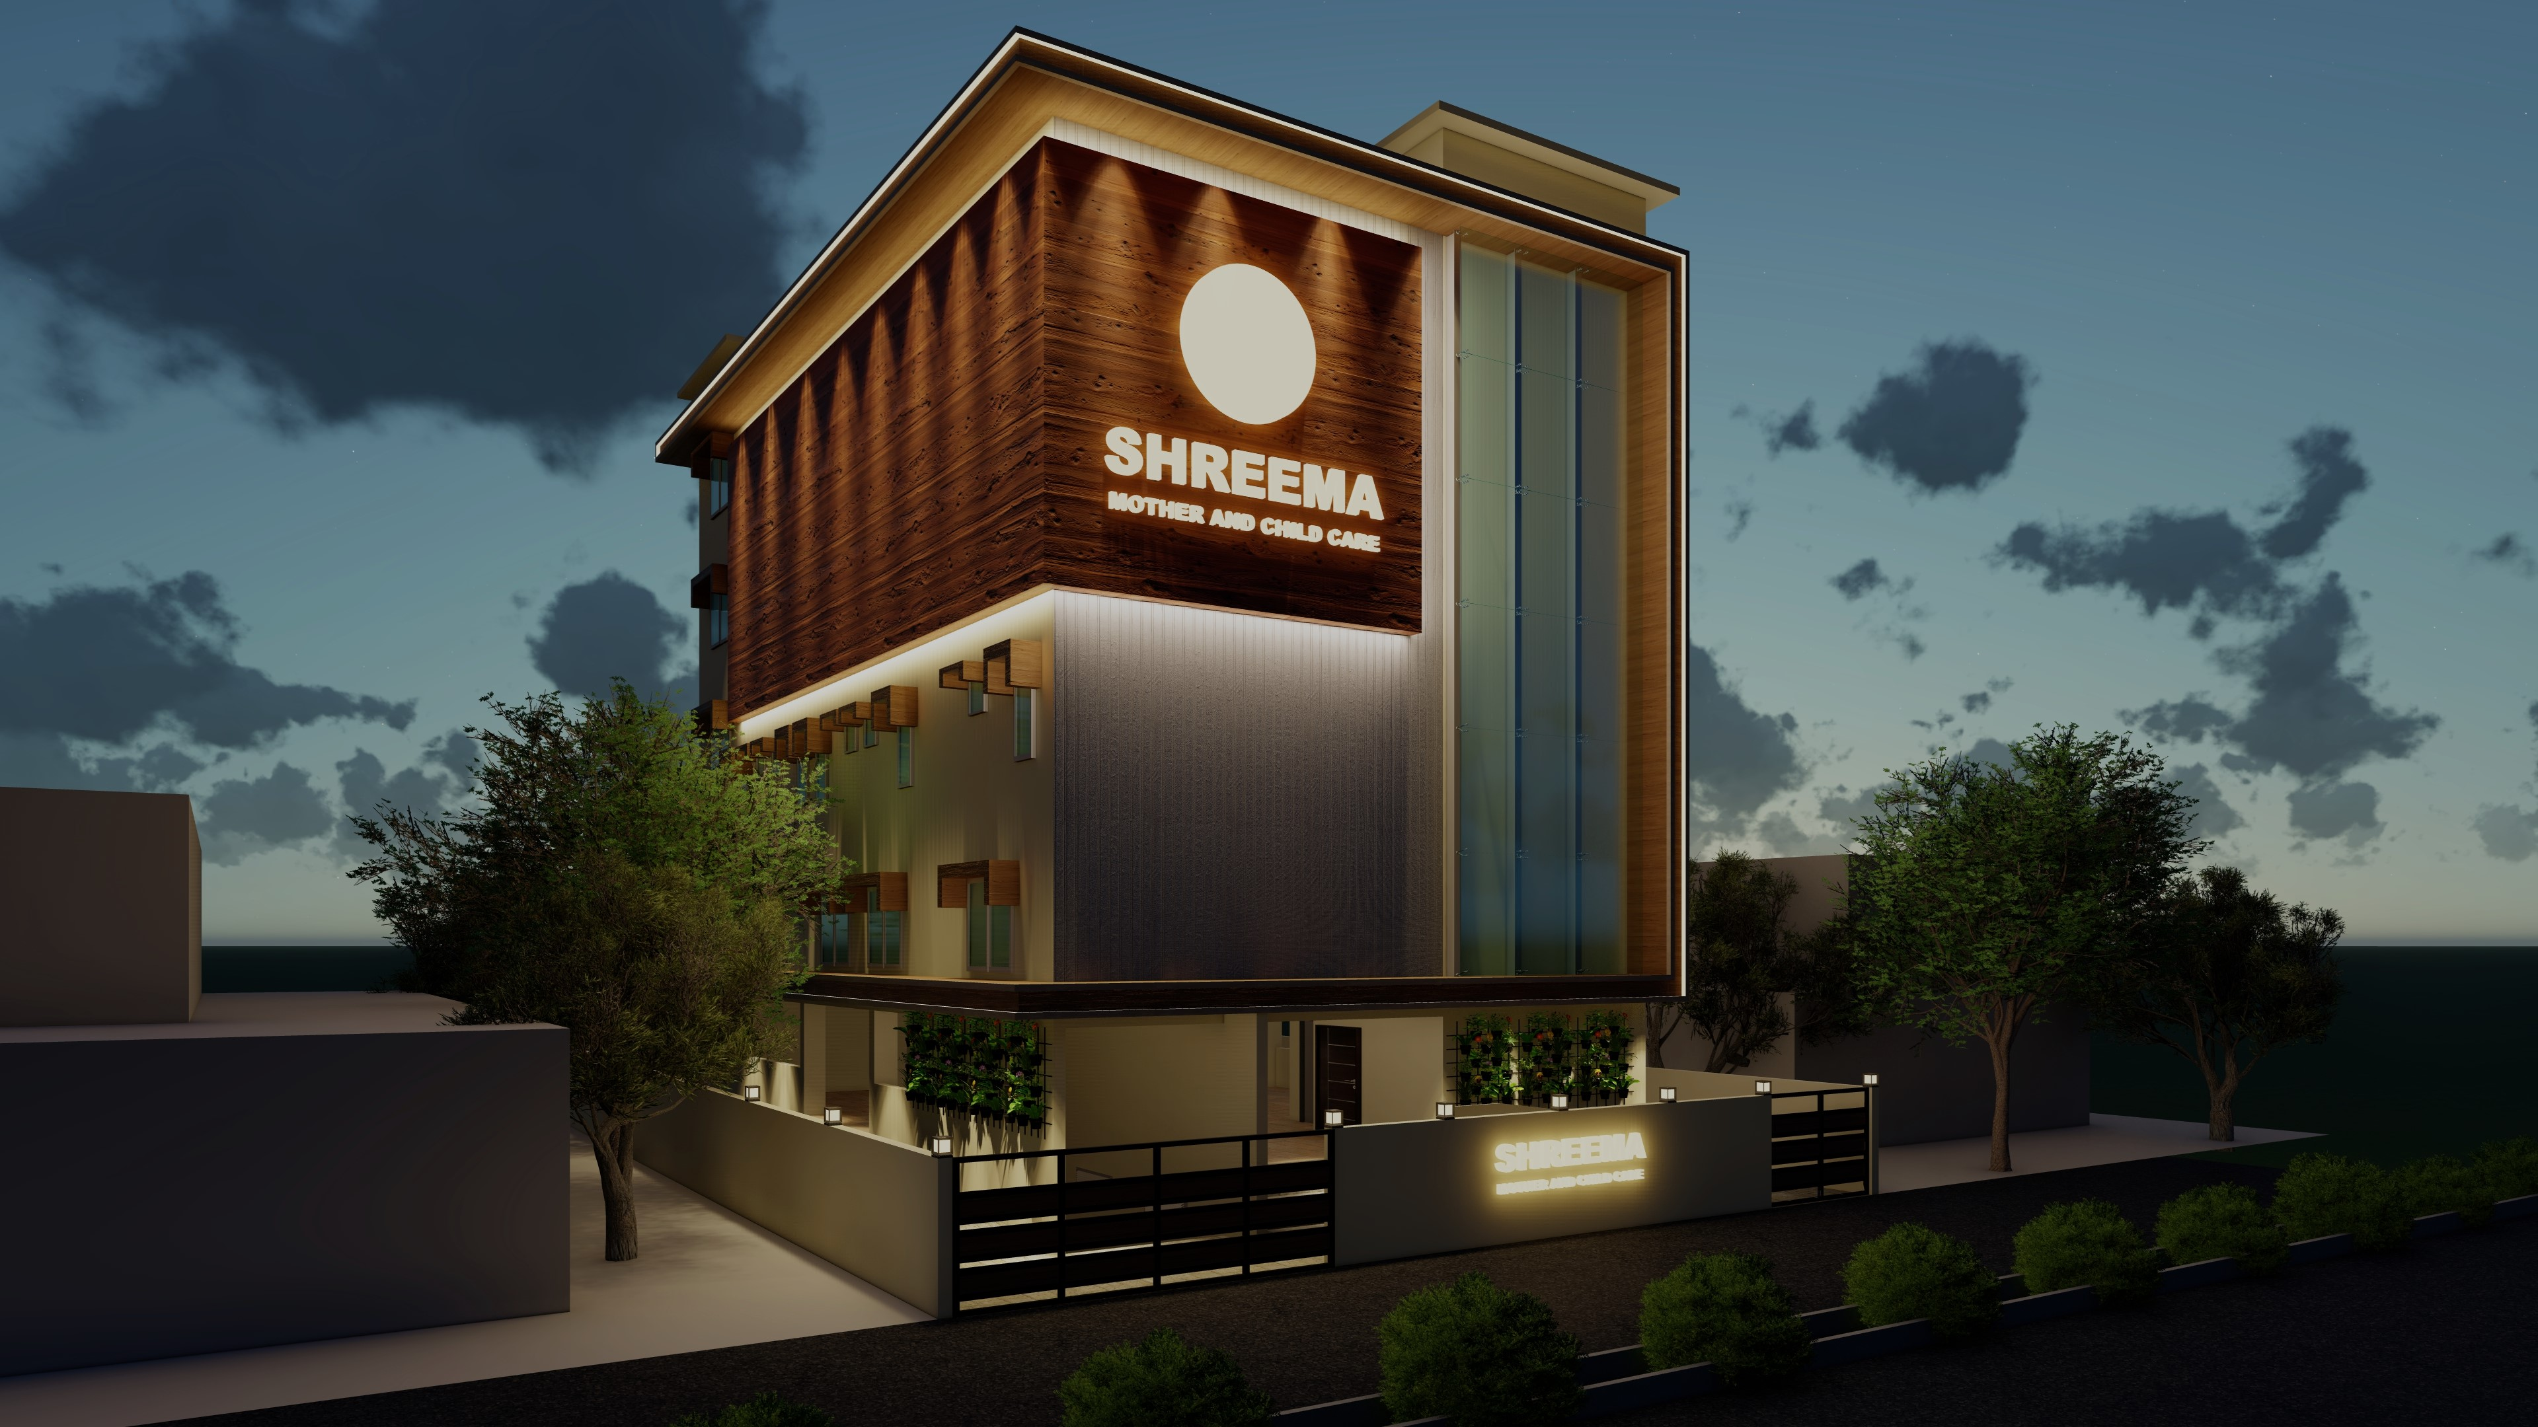

Slide 8
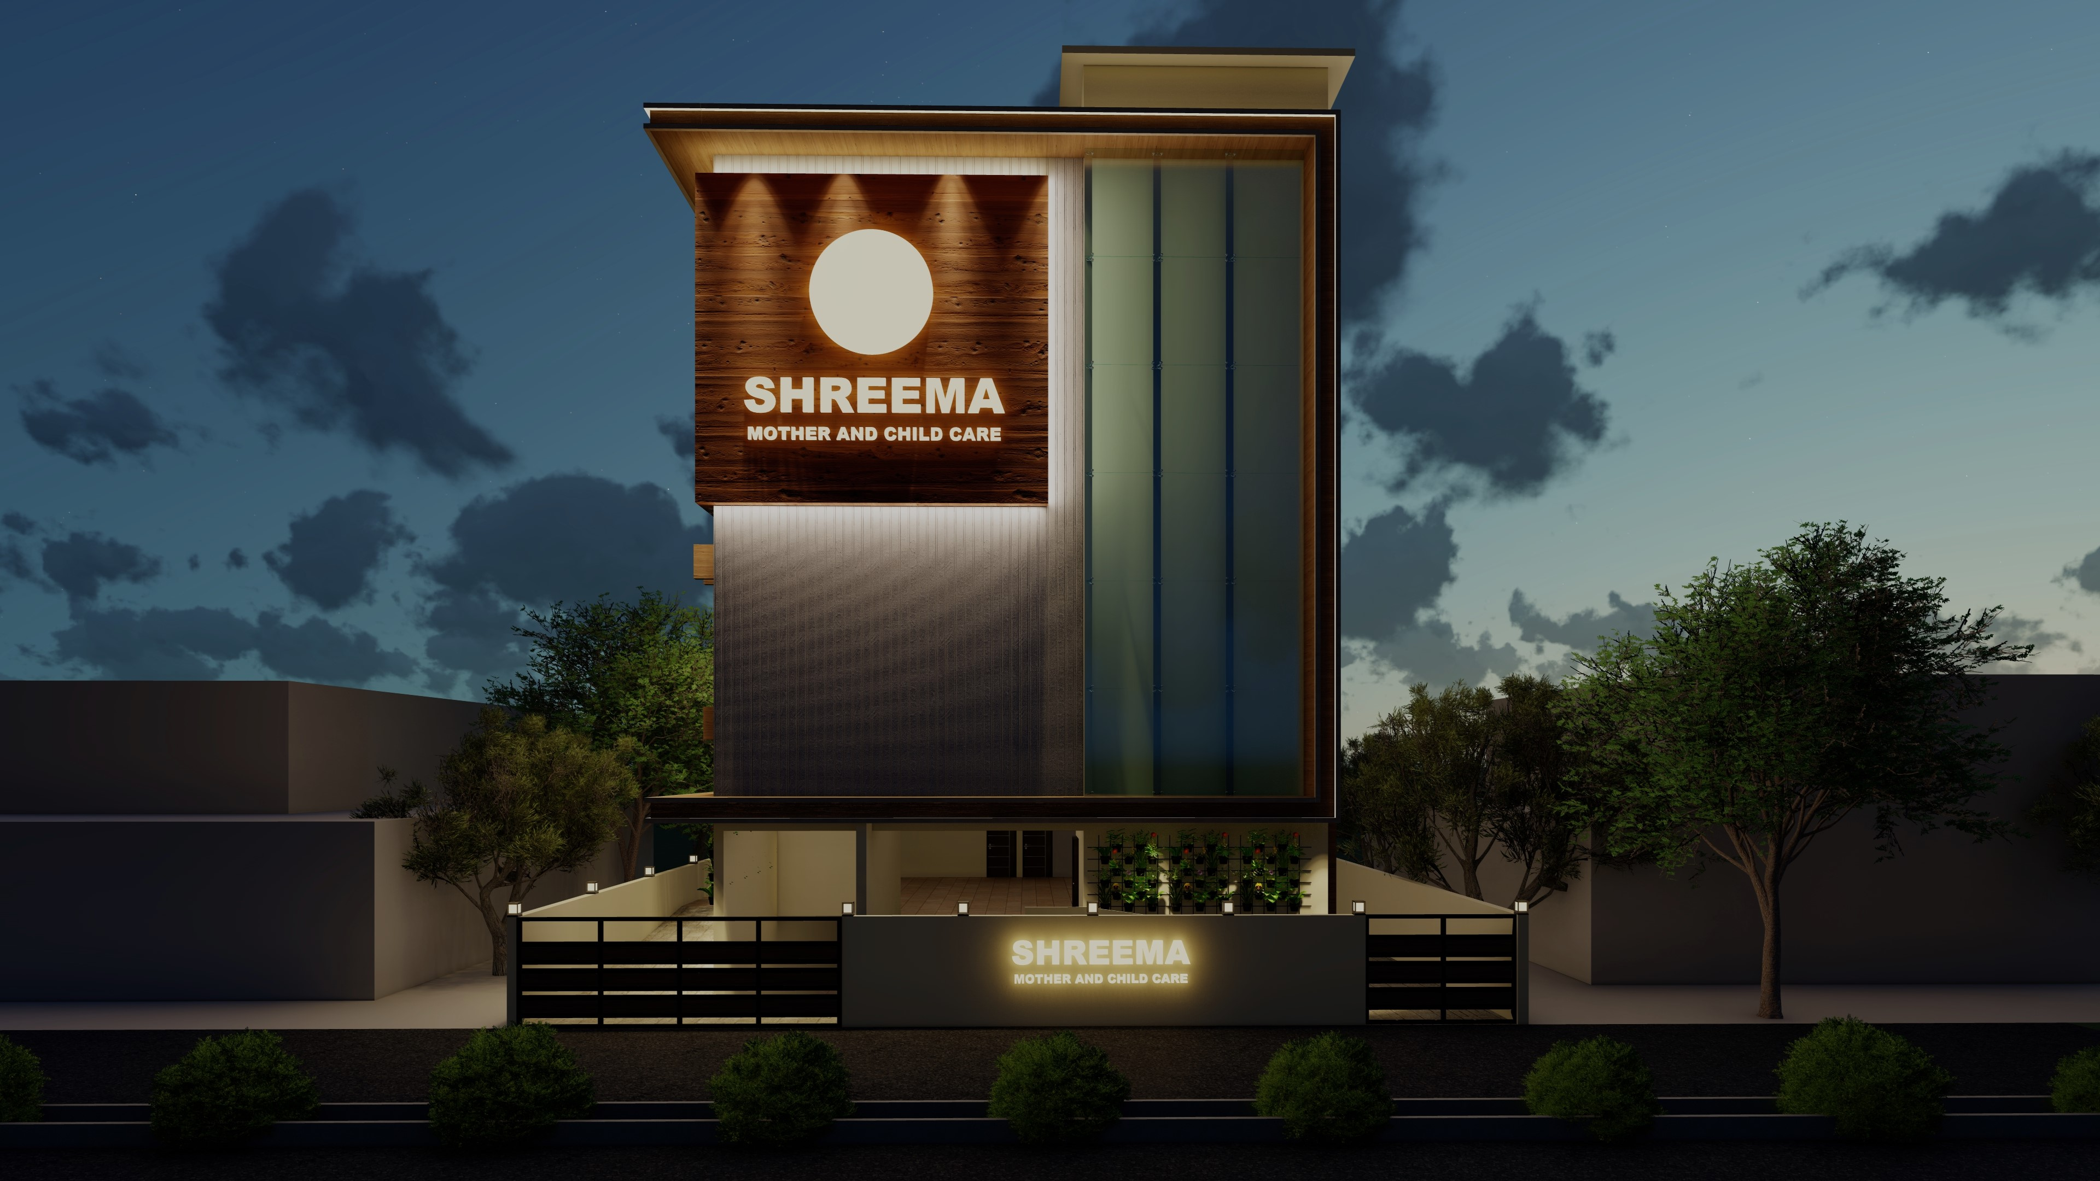

Slide 9
